Slide 1
Recovery and Regeneration
Road to Success
Dr E. Laura Cruz
drlaura@pivotsmo.com

Slide 2
Recovery and Regeneration Goals
Understand that Recovery and Regeneration are part of effective training
Recognize stresses that impact on training
Understand how different R&R techniques can help prepare for training
Be able to explore which of these techniques can be easily incorporated into daily routine

Slide 3
Recovery and Regeneration: The new “R&R”
R&R should be an integral part of training
Includes awareness of stress to the gymnast: internal and external
Includes warm downs; stretching and other self care techniques
Includes appropriate post training snacks and hydration
Includes adequate diet, hydration & sleep
Includes times for emotional support/outlets

Slide 4
Elite Athlete = Gifted Athlete X 10 yr / 10,000 hr of training
“Ultimately success comes from training and performing well over the long-term rather than winning in the short-term. There is no short cut to success in athletic preparation”
Balyi, 2001

Slide 5
Effective training relies on the body’s response to hard work followed by rest and recovery time

Slide 6
Effective training includes rest and recovery time; it does not end at the gym door.
.

Slide 7
Training and other “Stress”
Over –training or under-recovery leads to suboptimal performance
Training is a physiological stress, or physical stress
Other stresses can be within an athlete, or external and outside of the athlete
Each athlete has her unique response to stressors

Slide 8
Other Types of Stress
Examples are:
Travel and schedule challenges
Altered sleep routine
Comps back to back w/o rest time
Environment- air, temp, equipment
Athlete injuries, illnesses, anemia
Emotional, anxiety, fatigue related

Slide 9
Symptoms of Over-training or Under-recovery
Unexpected or persistent fatigue
Muscle soreness
Weight loss
Decreased coordination
Mood changes
Feeling stale
WHEN NOT CORRECTED LEADS TO POOR PERFORMANCE & INCREASED INJURY

Slide 10
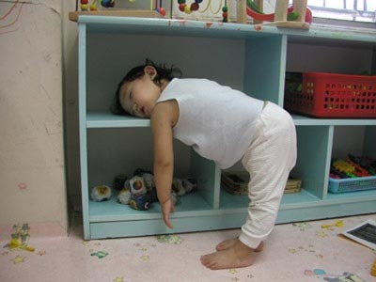

Slide 11
Best Start
Healthy Athlete
Healthy Diet
Adequate Hydration
Awareness of growth rate/ pubertal status
Regular periods

Slide 12
Best Rest/ Recovery
Post training snack
Warm down then- recovery & regeneration
Relaxation
Sleep

Slide 13
Best Recovery/Regeneration
Stretching
Cooling
Heating
Soft tissue therapy eg massage, ART, fascial stretch
Compression
Supplemental nutrients

Slide 14
Why is “R&R” important for Training?
Tissue recovery
Muscle recovery
Athlete recovery

Slide 15
Recovery and Regeneration
Important because training is a stress on the body
Depletion of energy reserves
Increased body temp
Mechanical muscle damage
Oxidative stress to tissues
Inflammation
Nervous system fatigue

Slide 16
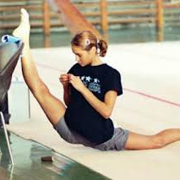
STRETCHING

Slide 17
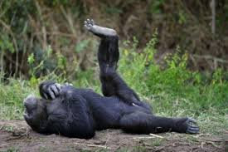
Stretching- Why, When, How
Decreases muscle soreness after exercise
Improves circulation to muscles
Increases muscle flexibility
Decreases tension at muscle –tendon- bone junction
Facilitates optimal joint mobility
Is relaxing!

Slide 18
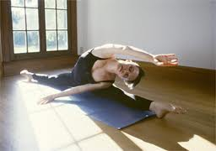
Stretching- Why, When, How
Stretching is not a warm up
Best done after exercise, with warmed up muscles
Daily- bedtime is good

Slide 19
Stretching- Why, When, How
Static stretching is slow and relaxed
30 sec , 3 reps
Major muscle groups
Should not cause pain
Your special stretches
Specific muscles
Allow for your flexibility/ tightness

Slide 20
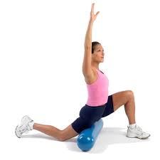
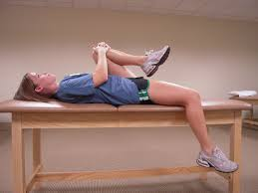
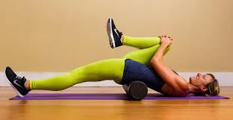
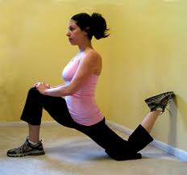
Static Stretching

Slide 21
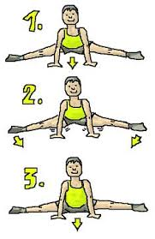
PNF/ Partner Stretching

Slide 22
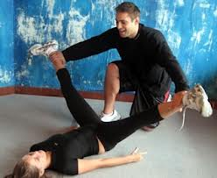
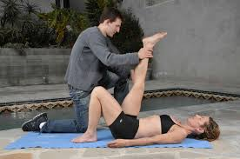
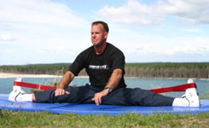
PNF/ Partner Stretching

Slide 23
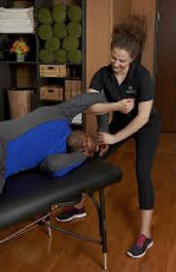
Fascial Stretch Therapy
Assisted stretching
Targeted muscles groups
“Realigns the body”
Improves blood flow, flexibility

Slide 24
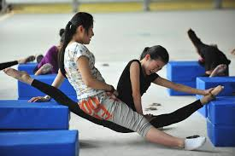
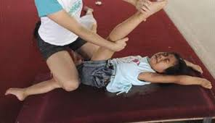
Stretching should not hurt like this

Slide 25
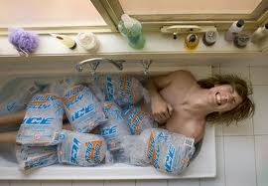
COOLING

Slide 26
Cooling Therapies
Feels Good!
Reduces inflammation
Reduces lactic acid build up
Reduces pain
May reduce heart rate
Enhances return to “resting” phase

Slide 27
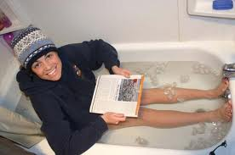
Ice Packs, Baths or Showers?
Packs good for single joints, muscles
Baths and showers better for whole body
Provide some compression
Immersion relaxes muscles more
Shower massages muscles
Recommended temp 10 - 15deg C for 15min
Wear your hat!

Slide 28
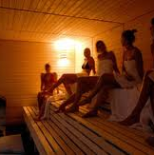
HEATING

Slide 29
Hot/ Cold Treatments
Better at “flushing” muscles
Hot and cold showers
Pool then sauna
Recipes vary
30 sec to 2 min, alternating for 5 to 10 times
Is said to be invigorating and energizing!

Slide 30
SOFT TISSUE TREATMENT
Oops……wrong photo!

Slide 31
Massage and ART
Science is not clear
Feels great- at least once its over!
May/ probably does improve
Circulation
Relaxation
Flush out waste products
Reduce inflammation
Break up adhesions and trigger points

Slide 32
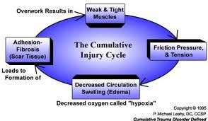
Tissue injury according to ART theory

Slide 33
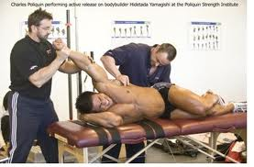
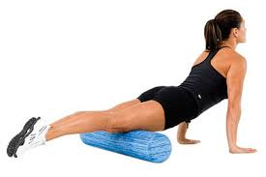
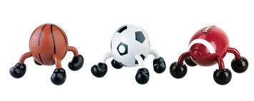
Techniques for soft tissue release

Slide 34
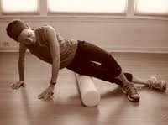
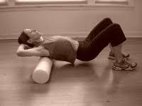
Foam Rolls

Slide 35
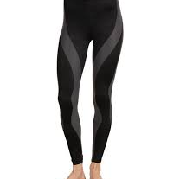
COMPRESSION

Slide 36
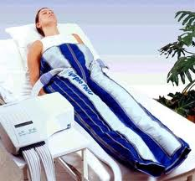
Compression: Another “feels good” therapy?
May decrease post exercise muscle soreness
Does decrease swelling
Improved circulation with gentle post training movement?

Slide 37
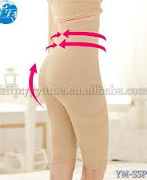
Easier to get?

Slide 38
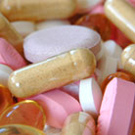
SUPPLEMENTS

Slide 39
Supplements
CONS
PROS
Do not replace a healthy athlete focused diet
May not be absorbed as well as food
Can be expensive
May not be proven
10 to 15% have banned substances, even in tested products
Can add to healthy diet
Can be reliable amounts of nutrient
Helpful for vegetarians
Helpful for iron levels
May help speed up recovery

Slide 40
Dr Trent Stellingwerff, CSI-Victoria

Slide 41
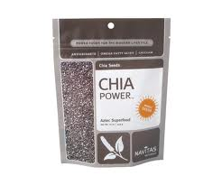
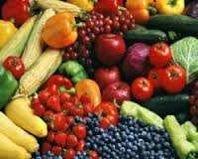
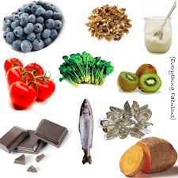
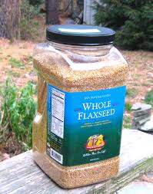
Food Sources of Antioxidants and Anti inflammatory products

Slide 42
Alex Hutchison, sweatscience.net, CASEM 2013

Slide 43
Successful Recovery and Regeneration
Adequate recovery time and sleep is key
Various techniques are helpful
Soft tissue treatments and cold therapy are most common
Eat “Recovery Foods” for repair and energy storage
R&R works best when done often and regularly- just like a new skill in training

Slide 44
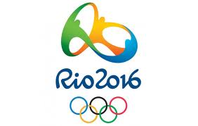
Questions?
Thank you for your attention!!
drlaura@pivotsmo.com

