Slide 1
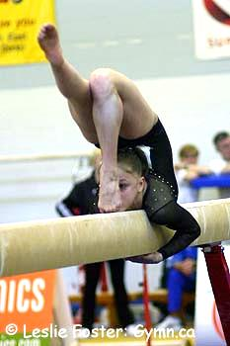
FUEL FOR SPORT: Eating Well for Elite Gymnastics Gymnastics Canada
Jennifer Sygo, M.Sc., RD
Registered Dietitian and Sports Nutritionist
Photo courtesy Leslie Foster

Slide 2
Healthy Food is All Around Us!
Every day foods
Sometimes foods
Not-very-often foods

Slide 3
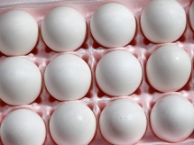
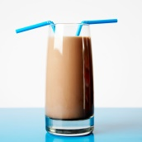
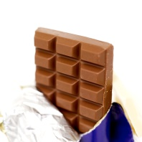
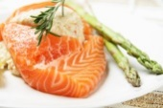
What type of foods are these?
FOOD | EVERY DAY | SOMETIMES | NOT VERY OFTEN
What happens if you don’t like every day foods?

Slide 4
Game Format
Teams of 5-6
Oldest person keeps score
Points for each question
Most points win

Slide 5
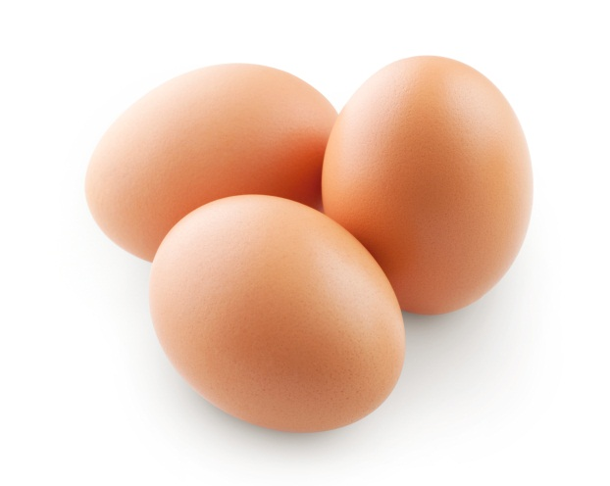
Question 1: Protein
Which of the following statements about protein is NOT true?
Protein helps us build and maintain our muscles
We burn protein during our workouts
We need protein for our bones and immune system
Protein helps us to feel full

Slide 6
Answer
We burn protein during our workouts (10 points)

Slide 7
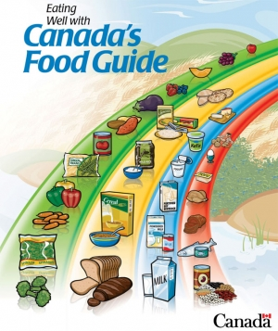
Question 2: Protein
There are 4 Food Groups in Canada’s Food Guide to Healthy Eating. Which 2 Food Groups give us protein? (remember to pick 2!)
Fruits and vegetables
Grains and cereals
Milk and milk alternatives
Meat and meat alternatives

Slide 8
Answer
Milk and milk alternatives (5 points)
Meat and meat alternatives (5 points)

Slide 9
Protein Foods
Chicken, turkey, beef, fish, shellfish
Milk, chocolate milk, soy milk
Cheese, cottage cheese
Yogurt and Greek yogurt
Nuts: almonds, walnuts, peanuts, cashews, etc.
Seeds: pumpkin seeds, sunflower seeds, hemp seeds, flax seeds, chia seets
Beans, chick peas, lentils, soy beans
Tofu and tempeh

Slide 10
Question 3: Balanced Snack
A balanced meal or snack should include a source of protein and a source of carbohydrates. Which of Sara’s meals or snacks isn’t balanced?
Breakfast: Cereal, banana, and milk
Lunch: Vegetable soup, granola bar, apple
Snack: Yogurt and blueberries
Dinner: Chicken, baked potato, broccoli

Slide 11
Answer
Lunch: vegetable soup, granola bar, apple (10 points)

Slide 12
Balanced Snack Ideas
Yogurt, berries, and granola
Smoothie with fruit, milk, and yogurt
Hummus and carrot sticks
Hard-boiled egg and whole grain crackers
Cottage cheese and pineapple
Whole wheat English muffin with cheese
Peanut or almond butter and apple or banana
Almonds, walnuts, or cashews, raisins, and Cheerios
Mini can of flavoured tuna and whole wheat pita
Whole grain cereal or oatmeal with milk
Leftover chicken in a whole wheat wrap

Slide 13
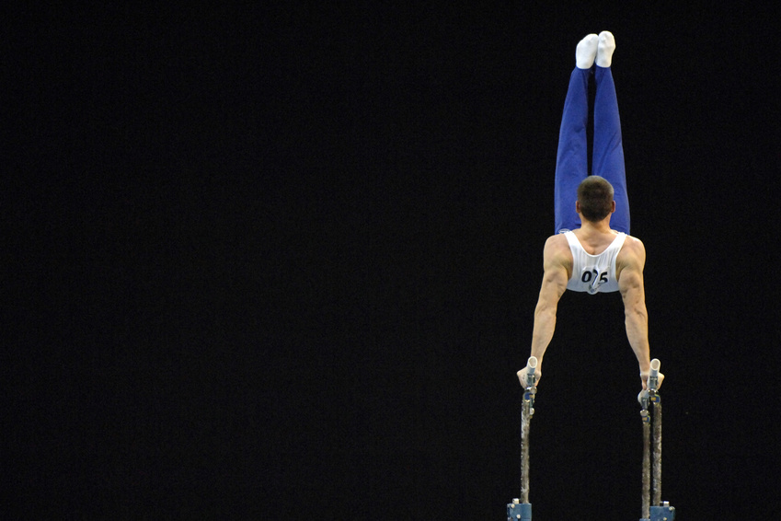
Question 4
You’ve just finished school at 3 pm, and you are supposed to start training at 4:15. What is your best meal or snack choice to fuel your workout?

Slide 14
Options
½ grilled chicken wrap on whole wheat and an orange
2 hard-boiled eggs and some veggie sticks
A handful of almonds and a cheese string
A glass of orange juice and a granola bar

Slide 15
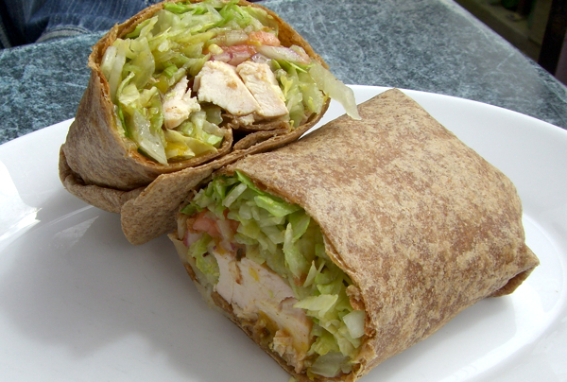
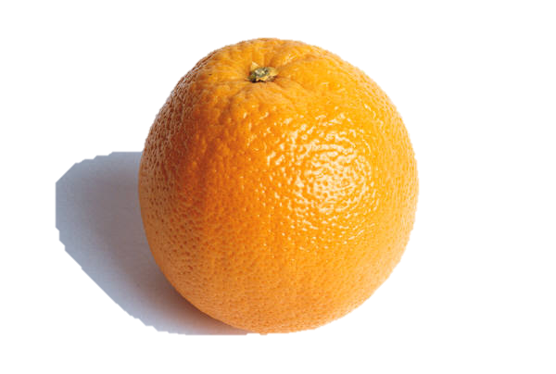
Answer
A) ½ chicken wrap on whole wheat and an orange
WHY?

Slide 16
Eating Before Training
If you’re eating about an hour before training, try to include a source of carbohydrates (for energy) and a bit of protein (for fullness)
Keep fat, fibre, and sugar low
Keep the meal small to moderate

Slide 17
Eating Before Training
Sample pre-training meals and snacks:
Chicken or turkey wrap (1/2-1) on whole wheat
Smoothie with milk/soy milk, banana, berries, yogurt
Chicken, tofu, shrimp, or beef stir-fry with brown rice and veggies
Whole wheat English muffin with cheese and a banana
Oatmeal or cereal with milk and berries

Slide 18
Question 5
What would be the best choice to eat right after finishing gymnastics in the evening?
Peanut butter on celery
Yogurt and a banana
Granola bar and Gatorade
Protein shake (1 scoop of protein powder in water)

Slide 19
Answer
Yogurt with banana (10 points)

Slide 20
Question 6
Some foods have natural sugar, and some are made with added sugar. Which of the following foods contains only natural sugar?

Slide 21
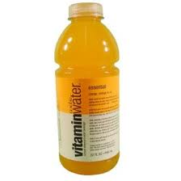
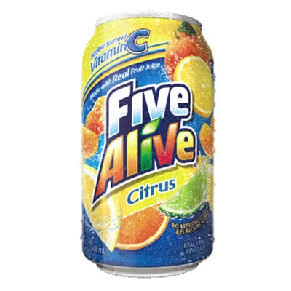
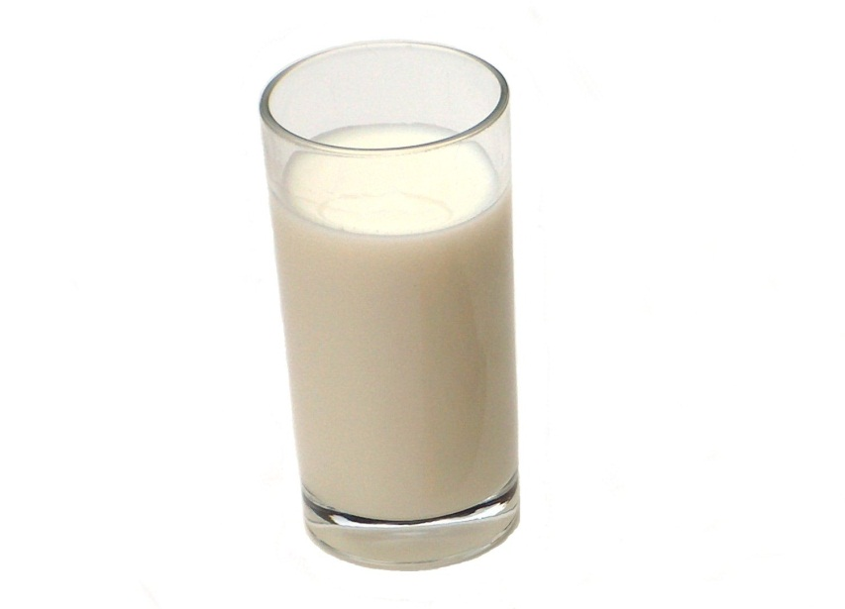
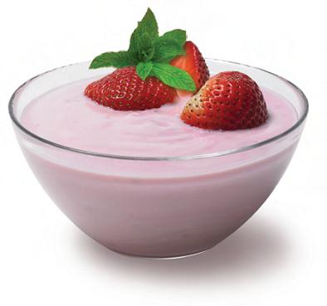
Options
Vitamin Water
Strawberry flavoured yogurt
5-Alive
Milk

Slide 22
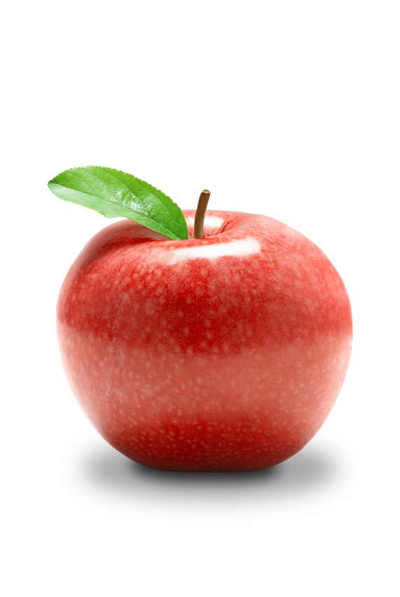
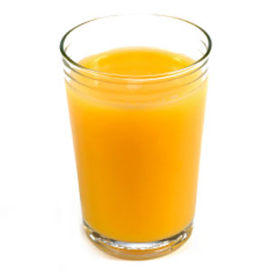
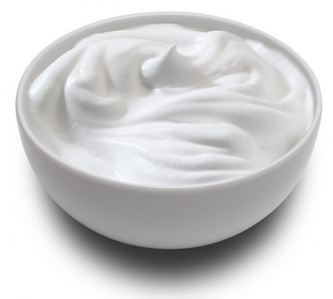
Answer
Milk (10 points)
What other foods contain only natural sugar?
100% fruit
juice
Plain yogurt
Fruit

Slide 23
Drinks: Top Tips
Drink water most of the time
Milk and soy milk are great choices for protein and calcium
Fruit juice is okay, but try for whole fruit more often
Watch for added sugar in fruit drinks (look for words ending in “-ose”)
Try not to drink diet drinks very often, if at all
A small amount (1 cup) of chocolate milk can be okay to help your muscles recover right after training

Slide 24
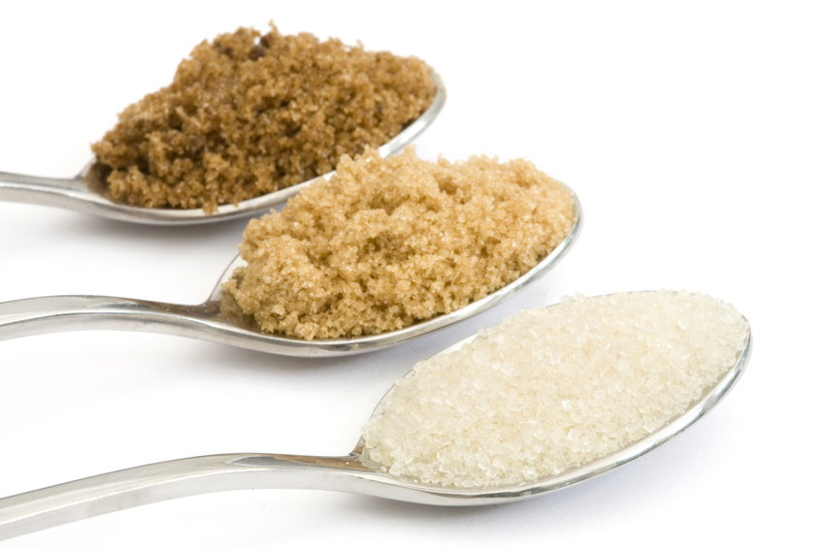
Question 7
To be healthy, we should try to eat less than 5 teaspoons (or 20 grams) of added sugar per day. Which of the following foods contains the most sugar?
1 teaspoon = 4 grams of sugar

Slide 25
Options
Can of cola
Medium Tim Horton’s Hot Chocolate
Small DQ Blizzard
Small McDonald’s milkshake

Slide 26
Answers (10 points)
Can of cola: 42 grams = 10.5 tsp
Tim Horton’s Hot Chocolate: 49 grams = 12 ¼ tsp
Small DQ Blizzard: 61 grams = 15 ¼ tsp
Small McDonald’s milkshake: 77 grams = 19 ¾ tsp

Slide 27
Tips for Cutting Down on Sugar
If you’re going out for ice cream, stick to a small or junior-sized cone, rather than a shake or ice cream treat
Drink plain water more often
Mix fruit-flavoured (sweetened) yogurts with plain yogurt to cut the added sugar in half
Mix chocolate milk with plain white milk
Look for cereals and granola bars with less than 8 g (2 tsp.) of sugar
Buy plain oatmeal or low sugar cereals and add your own sugar if you need to (you’ll probably add less than the people who make it)

Slide 28
…and the winner is…
THANK YOU!
jsygo@rogers.com
Twitter: @JenniferSygo
www.jennifersygo.com

