Slide 1
Getting it Right
Effective Training during Adolescence
Dr E Laura Cruz
drlaura@pivotsmo.com

Slide 2
Getting it Right Effective Training during Adolescence
Healthy training
Healthy growth and maturation
Healthy “down time”

Slide 3
Getting it Right Goals for today
Training-what your coaches know
Knowledgeable about puberty
Self assessment on personal stage
Understand how growth stage can impact on injury and performance

Slide 4
Getting it Right Goals Con’t
Understand the importance of nutrition
Detect signs of growth related issues
Learn how to self monitor

Slide 6
10 years , 10,000 hours
"It takes 10 years of extensive training to excel in anything"
Herbert Simon - Nobel Laureate

Slide 7
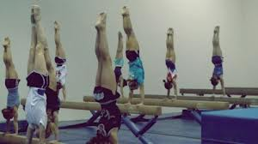
Healthy Training

Slide 8
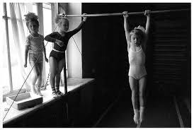
Healthy Training
Duration- # hours /day and per week
Training intensity- August vs mid season
Training cycle- periodization

Slide 9
Healthy Gymnastics Training
INCLUDES TIME FOR
Nutrition
Hydration
Everything else- school, family, friends

Slide 10
Healthy Periodization
Training schedule
Competition schedule
Post competition schedule
Off season

Slide 11
Goals of Periodization

Slide 12
Simple Concept

Slide 13
Complicated Schedule

Slide 14
Single Comp Prep- Acro

Slide 15
Healthy Growth and Maturation

Slide 16
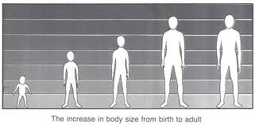
Healthy Growth and Maturation
Normal growth patterns
Height, weight & body composition changes
Late vs early “bloomers”

Slide 17
Effects of Growth on Gymnasts
Bony growth plates,
Bone density and strength
Muscle recovery, muscle strength
Flexibility

Slide 18
Healthy Growth
“A healthy teen is a growing teen”
Combination of
Genetics
Hormones
Adequate energy balance
Adequate nutrient balance

Slide 20
Istvan Balyi, CS4L Conference 2009, Ottawa

Slide 21
Normal Growth and Development: Tanner’s pubertal stages

Slide 23
Corresponding Height Changes
 | stage1 | Stage2 | Stage3 | Stage4 | stage5
Ht/ yr change | 2-3 in | 2-3 in | 3 + in | 2-3 in | 0
Avg Age | < 11 | 11- 12 | 12.5 | 13 yr | > 16

Slide 24
Growth Rates for Different “Bloomers” Height
Periods begin Avg 12.6 yr (10.8-14.5)
Peak Ht Velocity Avg 11.5 yr (9.7-13.3)
Pubertal growth rates:
Avg. 2.4-4 in /yr
Early 2.75- 4.33 in /yr
Late 2.1- 3.8 in /yr

Slide 25
Weight Gain
Growth = weight gain
50% of adult lean body mass is gained in adolescence
Puberty also changes % body fat and where it goes

Slide 26
Normal Wt Gain peaks at 12.5 yr

Slide 27
Late “Bloomers” or Delayed Puberty
Later age of fastest growth (PHV)
Later age of pubertal growth spurt
Delayed menses (periods)
Corresponds to SENIOR LEVEL of competition!

Slide 28
Istvan Balyi, CS4L Conference 2009, Ottawa

Slide 29
Benefits of Normal Growth and Development
Muscles get stronger!
Bones get stronger!
Joints become more lax (flexible)!
Brain-nerve- muscle connections improve!

Slide 30
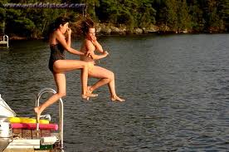
Healthy “Down Time”

Slide 31
Healthy “Down Time”
Rest and recovery strategies
Quality Sleep
Relaxation techniques

Slide 32
“R &R” or Rest and Recovery
Examples?
Enough food and fluids
Days off to chill
Stretching, massage, others
Longer rest after illness or injury
Cross training when able

Slide 33
Quality Sleep Nature’s Recipe for Growth and Recovery

Slide 34
Benefits of Sleep
Improved muscle recovery
Improved brain function
Improved immune system function
Lowered stress hormones ( normal metabolism)

Slide 35
Quality Sleep
How much?
How often?
Feeling refreshed next day?
Waking a lot?
Taking a long time to fall asleep?

Slide 36
“Sleep Hygiene”
Regular bedtime & wake up time
Avoid caffeine, alcohol, hot showers, exercise prior to bed
8 to 12 hr (56-70 hr/wk)
Dark, quiet, cool room
Comfy bed!

Slide 37
Relaxation
Physical and mental calming
Slows heart, breathing, stress hormones(fight or flight hormones)
Calms thoughts
Makes you happier!

Slide 38
Relaxation techniques= fun!
Music
Meditation
Reading
Socializing
Hobbies
GOOD R&R MEANS BETTER, HEALTHIER TRAINING!

Slide 39
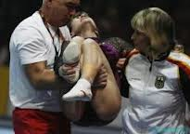
Getting it Right
Effective Training during Adolescence

Slide 40
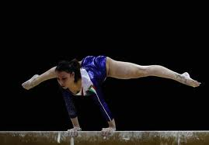
Getting it Right
Speed of growth impacts training
Bones are vulnerable at growth sites
Muscles are vulnerable at bony attachments
Coordination may be off affecting new skills
A Balancing Act

Slide 41
Getting it Right
Training too hard & too often during rapid growth leads to overtraining and injury
Eating too little for growth plus training increases risk
Poor recovery skills also affect health
A Balancing Act

Slide 42
What can happen?
Everyone is unique in growth and training ability
What happens if you grow too slow?
What happens if you grow too fast?

Slide 43
Slow Growth or Delayed Maturation
Growth plates of bones open longer
Tendon-bone junctions remain sensitive
Absence of normal reproductive hormones delays bone and muscle strengthening
Normal joint laxity changes are delayed

Slide 44
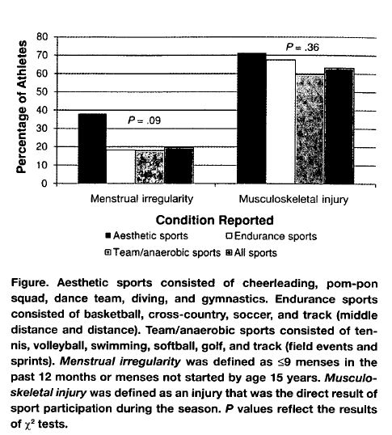

Slide 45
Bone Growth Plates

Slide 47
Injury to Growth Plates

Slide 48
Overload injury

Slide 49
Apophysitis Muscle tendon-bone sites

Slide 51
Osgood- Schlatter’s “Disease”

Slide 52
Achilles' tendonitis/ enthesitis

Slide 53
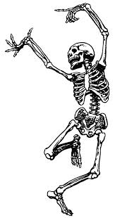
Bone Density/ Strength
Increases in early puberty
Bones get strongest after periods start
Maximum strength (density) at age 16
Healthy gymnasts have stronger bones!!

Slide 54
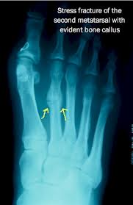
Delay in bone strengthening

Slide 55
Flexibility Changes

Slide 56
Flexibility = Supple muscles and Mobile joints
As bones lengthen muscles remain shorter
Muscle tension around joint increases
Joint mobility stays about the same until periods start (then increases)
Flexibility seems to decrease

Slide 57
Getting it Right
Long Term Athlete Development
A coaching and training approach

Slide 58
Gymnast’s Strategies for “Getting it Right”
Eat well and stay hydrated
Get enough sleep
Be/ get in shape
Measure height monthly
Ensure good muscle balance, strength and alignment
Do fun things and be happy!

Slide 59
Nutrition and Hydration
Adequate energy = muscle strength, growth and recovery after training
Adequate energy = normal puberty/ maturation
Poor/ inadequate diet = delayed puberty and prolonged risk of injury
FUEL YOUR BRAIN, BONES AND MUSCLES WELL!

Slide 60
Key Nutrients
Water- pale pee is key!
Carbs
Grains, starchy veg eg sweet potatoes
Protein
Meats, fish, eggs, soy, quinoa
Iron
Dark green leafy veggies, red meats
MORE ON THIS TOMORROW!!!

Slide 61
Monitor your Nutrition
Consider regular blood tests
Always tired and sore?
Low blood (anemia); protein levels; thyroid function
Reproductive hormones
Calcium, magnesium, Vit D
Iron levels
“Low normal” can be improved

Slide 62
Monitor your Height (every 1 to 3 mos)
Height increases quickly in mid puberty
Allows for training adjustments
more stretching,
more skills,
less pounding and repetition

Slide 63
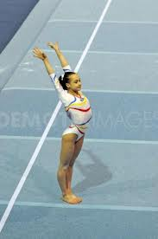
Correct Alignment and Muscle Imbalances
Some muscles get too strong
Some muscles stay too tight
Affects posture
Affects landings

Slide 66
Poor Postural Alignment

Slide 67
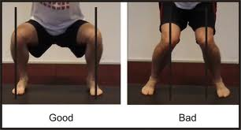
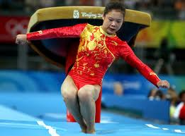
Assess Hip- Knee Alignment

Slide 68
Flexibility, Muscle Imbalances, Alignment
Take note if your flexibility is changing
Check for height changes
Monitor joint and muscle pain, swelling
Get help (coach, therapist, doctor)

Slide 69
Growing bones and muscles: What to watch for…
Pain and possible swelling at ends of bones
Pain and possibly swelling where muscle/tendon attaches to bone
Muscle pain and tightness when stretching
Worsening pain: back, hip, knee, heel, elbow

Slide 70
Gymnast’s Strategies for “Getting it Right”
Eat well and stay hydrated
Get enough sleep
Be/ get in shape
Measure height monthly
Ensure good muscle balance, strength and alignment
Do fun things and be happy!

Slide 71
Thank you!!!
Any Questions????
drlaura@pivotsmo.com

